Slide 1





TRANSSC
Transport Safety Standards Committee
2024 - 2026
WELCOME

Slide 2
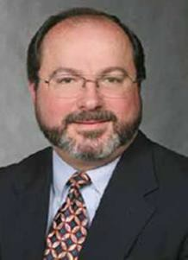
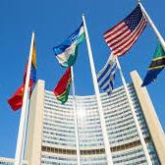
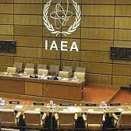
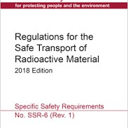
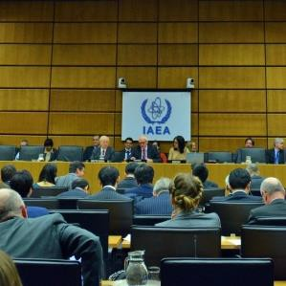
CHAIR
David PSTRAK
Mr. David Pstrak is a Senior Project Manager in the Division of Fuel Management in the Office of Nuclear Material Safety and Safeguards at the U.S. Nuclear Regulatory Commission (NRC). He joined the NRC in 2000 and has over 25 years’ experience with radioactive material packaging and transportation, including 20 years’ experience with packaging, transporting, and storing spent nuclear fuel. David is the instructor for the NRC’s “Transportation of Radioactive Materials” course (H-308). David is Chairman of the Transport Safety Standards Committee at the International Atomic Energy Agency.

Slide 3


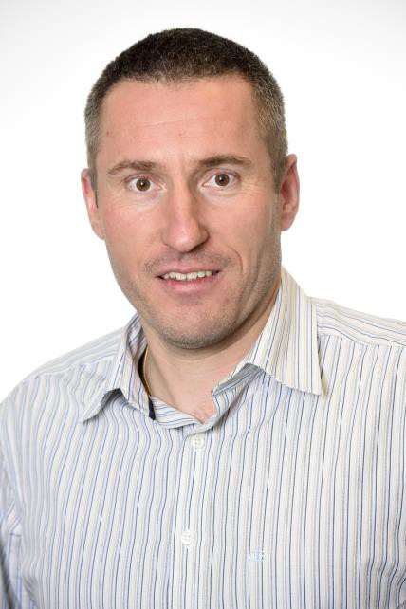
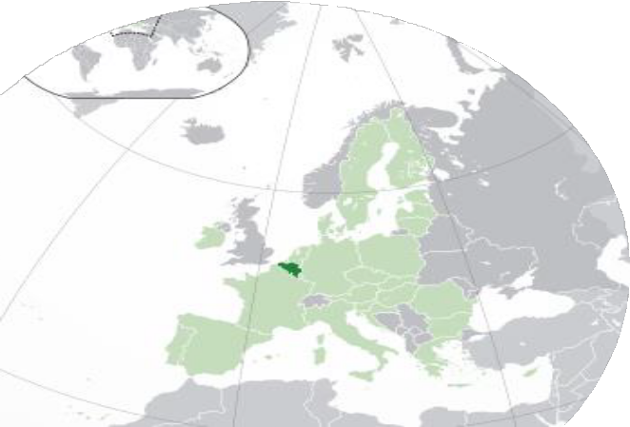
Belgium
Guy LOURTIE
Guy Lourtie is graduated Master of engineering in electrical engineering from the University of Liège, Belgium (1995). He worked from 1997 to 2009 for the Belgian business unit of SGS Group performing the safety inspections of technical installations (LV and HV installations, lifting equipments, lifts, pressure equipments, etc). He joined the FANC in January 2010 as Head of Import & Transport Unit. The Import & Transport team of the FANC is responsible to assess the Package Design Safety Report, to issue the approval of the package design, to evaluate the application and grant the license for the transport and import of radioactive material on Belgian territory, to ensure the compliance to the regulations for safe transport of radioactive material by inspections and audits.
He is the Belgian representative at TRANSSC (IAEA) since 2011.

Slide 4



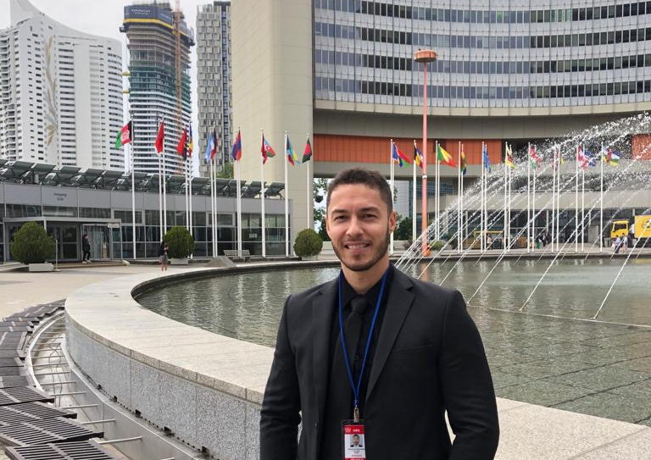
Brazil
Leonardo Vicente da Silva Matos
Mr. Matos, graduated in petroleum engineering, shortly after his graduation, worked with oil well drilling and logging. Since 2014, he has been part of the Brazilian nuclear regulatory authority, directly involved in the licensing and control of radioactive materials transportation.

Slide 5





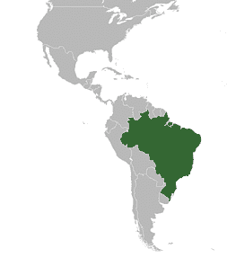
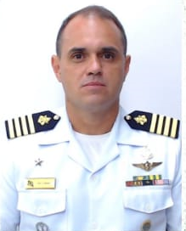


Brazil
Luiz Antônio Dias DO CARMO
Mr. Do Carmo is a Captain in the Brazilian Navy and trained in Special Operations and CBRN Defense. In 2020, Mr. Do Carmo was head of the Security Department of the Brazilian Navy Technology Center in São Paulo (CTMSP) at its two sites (São Paulo-SP and Iperó-SP). From 2021 to 2023 he served as Commander of the CBRN Defense Battalion of Aramar, the Unit responsible for security and safety at the CTMSP site in Iperó-SP (Aramar Experimental Center – CEA) and for the transport of nuclear material for the Navy Nuclear Program. Since February 2023, he works in the Institutional Security Cabinet of the Presidency of the Republic of Brazil as Nuclear Security General Coordinator of Brazilian Nuclear Program Protection System (Sipron).

Slide 6


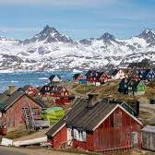
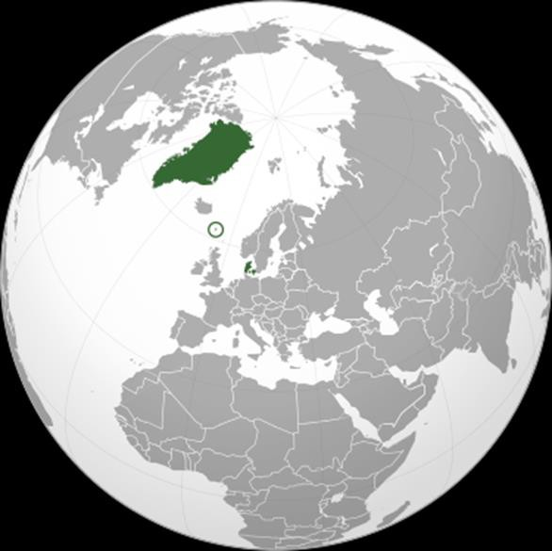
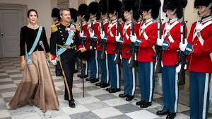
Denmark
Tim Mølgaard Lundby
I have worked for many years as a Healthcare Professional at the Nuclear Medicine Department, Rigshospitalet in Copenhagen, with management of radiopharmaceuticals and as a part of that process, radiation protection. I started as transport inspector at the Danish Health Authority, Radiation Protection in 2022 and has become a member of TRANSSC from this year, 2024.

Slide 7


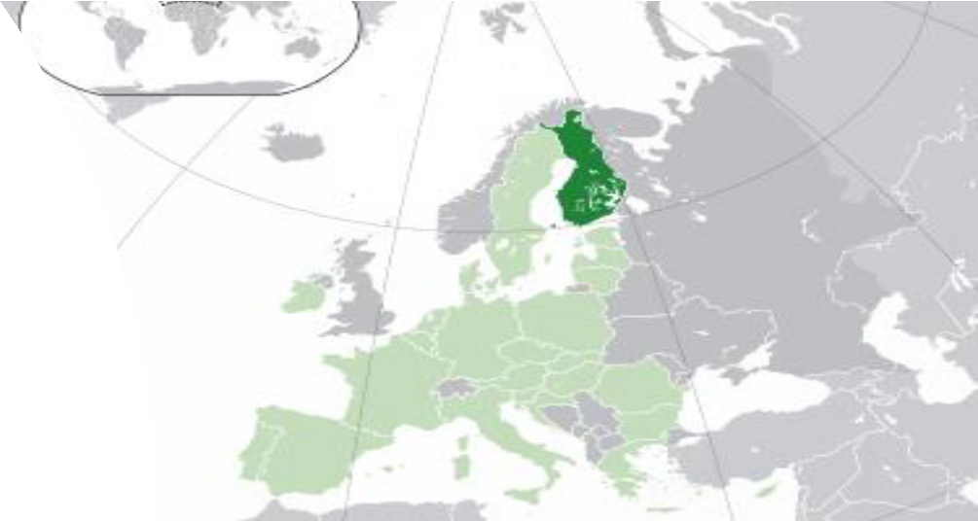
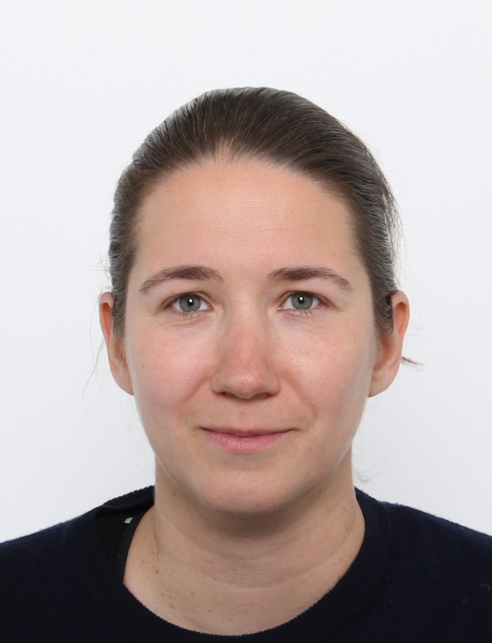


Finland
Anna Neilick
Anna Neilick is an inspector at the Finnish Radiation and Nuclear Safety Authority (STUK), where she specializes in the transport of radioactive material. She has participated in the work of the TRANSSC Committee since 2023. Anna has a master's degree in economics (commercial law). Anna has professional background in transport of dangerous goods as a safety and security advisor, instructor, consultalt and in air cargo handling operations.

Slide 8








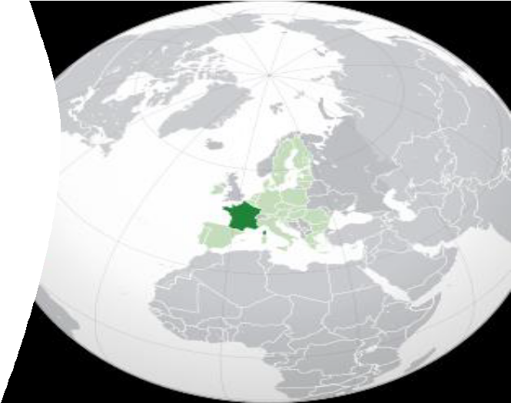






Slide 9
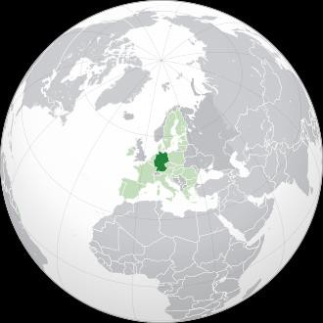


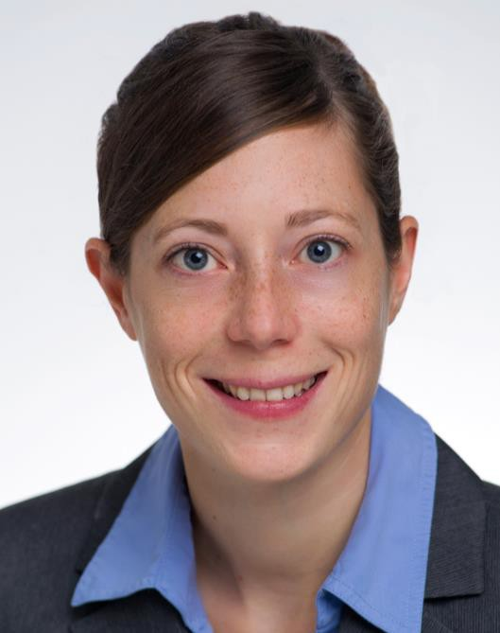

Germany
Anne Endres received the Ph.D. degree in nuclear physics from the University of Cologne, Germany, in 2012. Following her Ph.D. degree, she worked as a Postdoctoral Research Fellow with the Goethe University Frankfurt, until 2015. Since 2015, she has been working as federal ministry speaker at the federal ministry for the Environment, Nature Conservation and Nuclear Safety, Bonn, Germany.
Anne ENDRES

Slide 10


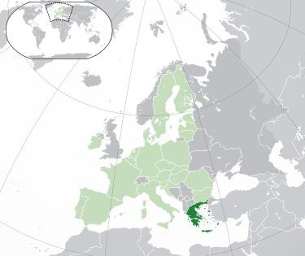


Greece
Stavroula VOGIATZI
She has been working for the Greek Atomic Energy Commission (EEAE), national competent authority for radiation and nuclear safety, in the Department of Licenses & Inspections, for the last 19 years. She holds the position of Special Scientific Personnel and acts as Technical Manager for the regulatory control of the transport of radioactive material and nuclear fuel, nuclear medicine practices and facilities to EEAE's MS
In addition to inspections, review & assessment and authorisation of practices and facilities, her duties in EEAE include: drafting of legislation and regulations, lectures in postgraduate courses, international/national training programs and seminars, participation to R&D projects, national delegate to international/European committees and working groups, participation to the EPR team of EEAE.
She has experience in international cooperation and activities for more than 20 years. She is supporting IAEA activities as an expert, including the Integrated Regulatory Review Service (IRRS) Missions. She has been TRANSSC member since 2005; she serves as the first chairperson of the Mediterranean Network (MedNet) for the transport of radioactive material since 2015. She holds a B.Sc. Degree in Physics from EKPA University of Athens, Greece, an MSc Degree in Medical Physics from the University of Aberdeen, UK, Professional License as Medical Physicist and Recognition as Radiation Protection Expert for medical and non-medical practices.

Slide 11


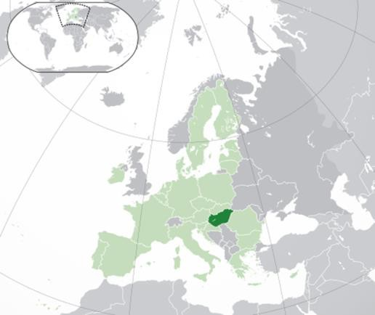
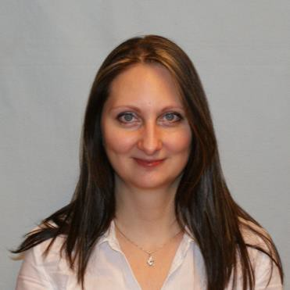

Hungary
Tünde KATONA
Ms Tünde KATONA is Hungary's official delegate at TRANSSC in the last three years and its observer since 2011.
She is a regulator working at the Hungarian Atomic Energy Authority as a professional advisor responsible for RAM transport safety and security.
Her professional background is environmental engineering specialized in radioecology, and has PhD in environmental sciences.

Slide 12


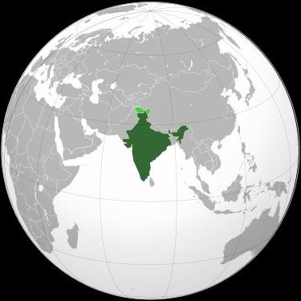
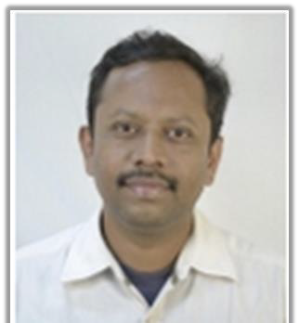
Design, Simulation and Review of Transportation Cask Designs to Evaluate Performance and Qualification with respect to AERB/IAEA Regulations. Development of SAR and Applications, for Type Approval from AERB/ BARC Safety Council.
Review and Upgradation of BSC/AERB Regulations pertaining to Shipping Casks; Standard Operating Procedures (SOP) for conducting Physical Drop Tests of Shipping Casks and Validation Models; SOP for Numerical Simulation Analysis of Shipping Casks through Computer Models.
Experimental Validation studies during Qualification of Packages as per AERB/IAEA Regulation. Expertise in Design and Analysis of various Packages for Transportation of Radioactive Materials.
Member of Task Force to Review Applications for Design Approval of Packages for Transportation of Special Materials; BARC Safety Council - SRC-TRM and AERB (INDIA) - COSTRAM.
India
Vivek CHAVAN

Slide 13
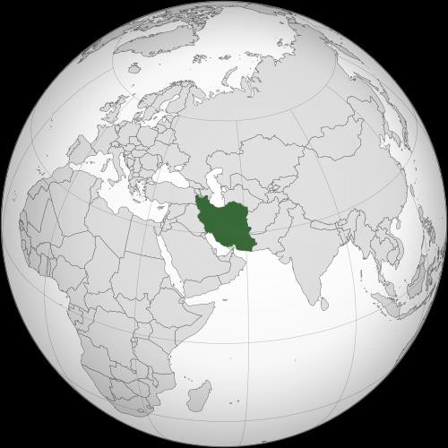


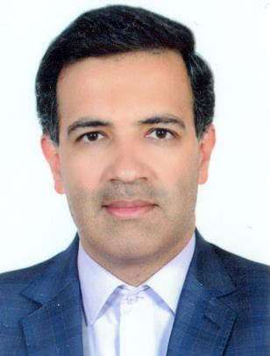
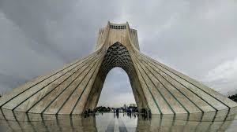
Iran
Hossein KARIMI ASHTIANI
2018-Now Head of “Safety Assessment of Radiation activities” Section
2013- 2018: Head of “Transport of Radioactive
Material & Inventory” Group
2010-2011: Post Graduate in Radiation Protection and Safety of
Radiation Sources at University Science of Malaysia
2007-2010: M. S. in HSE Engineering & Incident
Management at Tehran University

Slide 14



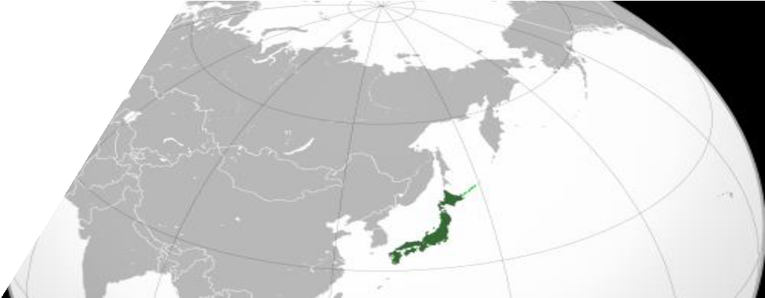

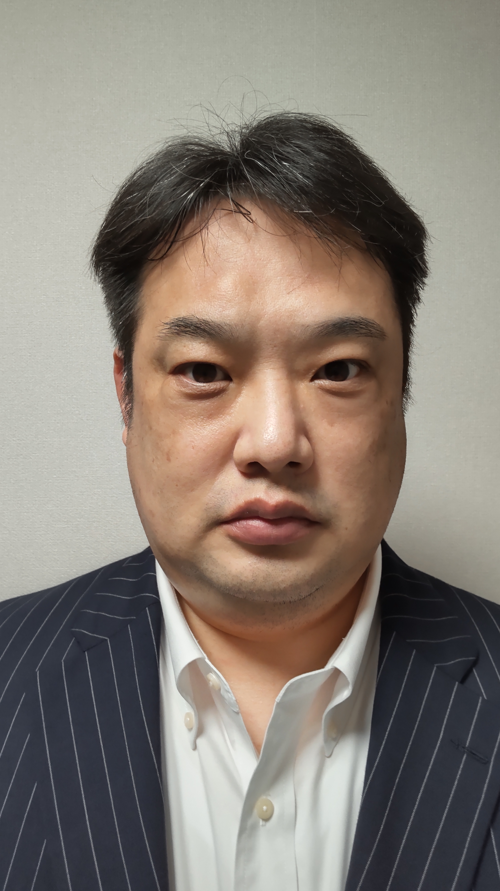
Japan
Masakazu SHIMA
Director of Division of Licensing for Research Reactors, Use of Nuclear Material and Specified Nuclear Facilities, Nuclear Regulation Authority, which is the competent authority for nuclear and radioisotope safety in Japan
Member of TRANSSC from 2022

Slide 15

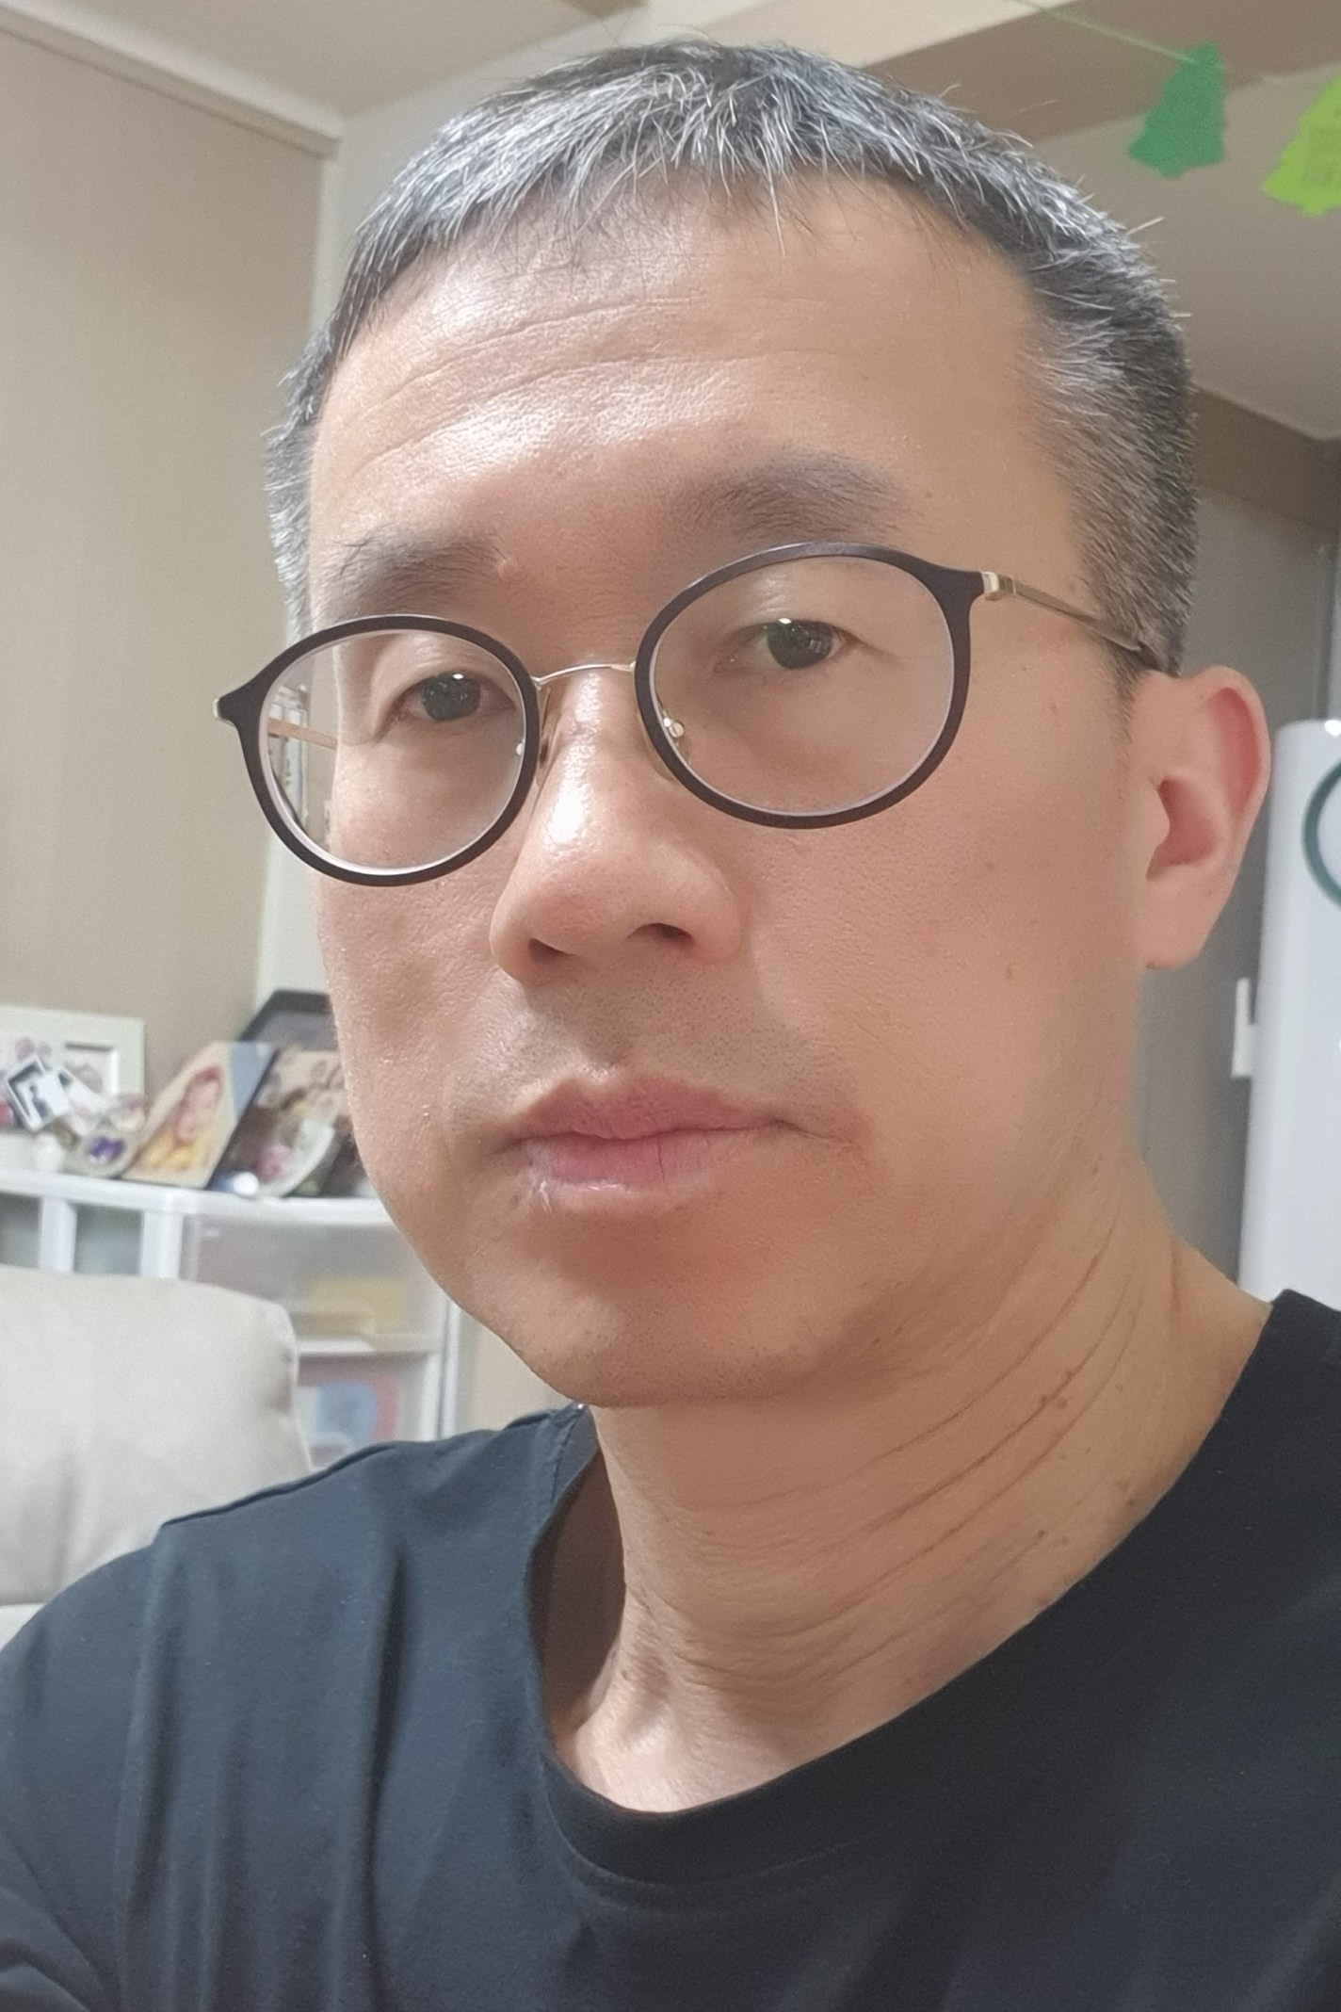
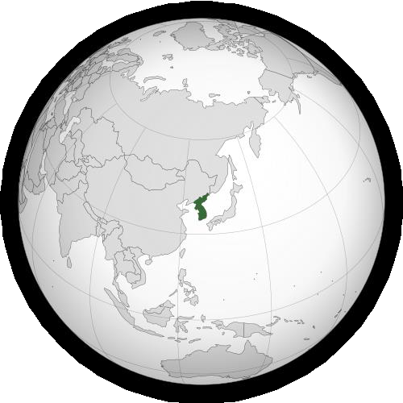


Republic of Korea
Youn Hwan PARK
Master Degree in radiation detection and measurement & health physics in 1996
About 21 years' experience of technical review and inspection of manufacture, distribution and (mobile) use of Radioactive material and Radiation generating devices at KINS(Korea Institute of Nuclear Safety). Having been involved in regulation of transport of radioactive material since 2014.
Currently, Chief of a department for regulation of radiation treatment in industries since 2017

Slide 16
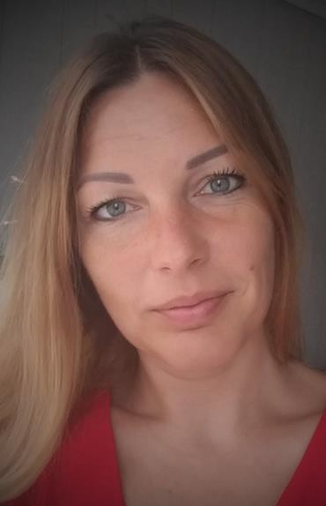
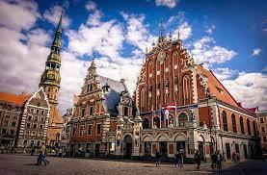
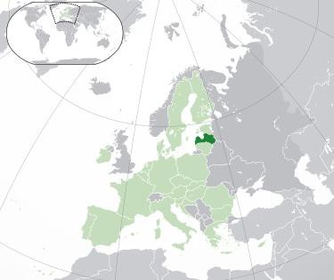

6 years as inspector in Radiation Safety Centre of State Environmental Service of Latvia. Duties - conducting inspections, participation in the response team in cases of emergencies, incidents or accidents, participation in the development / updating of legislation, guidelines, also organization of training and practical exercises related to response in radiological incidents and use of measuring equipment.
Latvia
Inese MARTINSONE

Slide 17


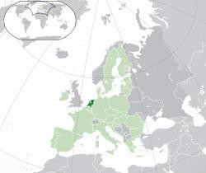

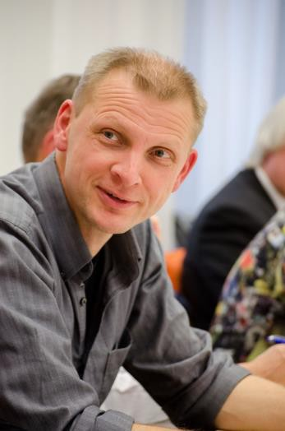
Netherlands
Mathieu Ter Morshuizen, aged 48, married, 2 daughters. Current position: Senior policy officer for safe and secure transport of radioactive materials with the Dutch Authority for Nuclear Safety and Radiation Protection ANVS. TRANSSC member since 2007.
Background: MSc Applied Physics (Seismics & Acoustics), Senior Project Manager, Radiation Protection Expert (RPE/CD), Leading Firefighter (HBT), Hazardous Materials Officer (CDR/MPL). Chair of European Association of Competent Authorities (EACA) since 2017. Hobbies: cooking (& eating), trombone (beginner), hiking.
Mathieu TER MORSHUIZEN

Slide 18

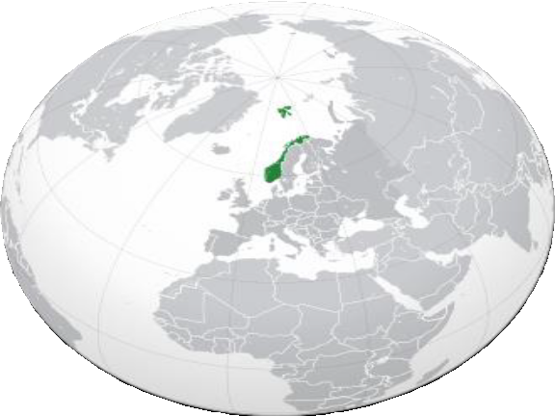


Norway
Joe Moussa
Joe Moussa joined the Norwegian Radiation and Nuclear Safety Authority (DSA) in 2021. As an Advisor, he is working with regulations related to the transport of radioactive material, including those related to radiation protection. His work includes review of applications for the approval of package designs and inspection of companies and facilities involved in the transport of radioactive material. Before joining DSA, Mr. Moussa worked as a researcher in the field of radiation measurements and waste characterization. He holds a master’s degree in nuclear engineering.

Slide 19

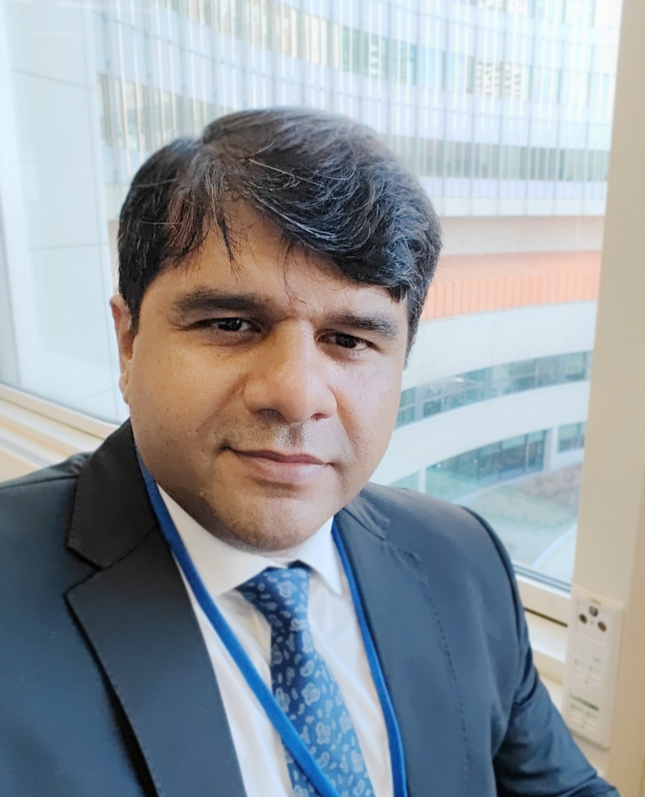
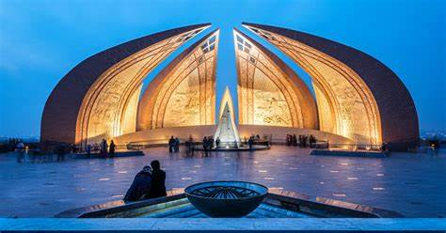
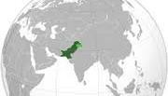
Principal Engineer
Pakistan Nuclear Regulatory Authority Islamabad, Pakistan
Mr. Qureshi has 17 years of regulatory experience in the domains of regulatory framework, authorization, review & assessment and inspections & enforcement. His areas of expertise are Transport safety, Nuclear safety , manufacturing & Testing.
Pakistan
Majid Akhtar Qureshi

Slide 20


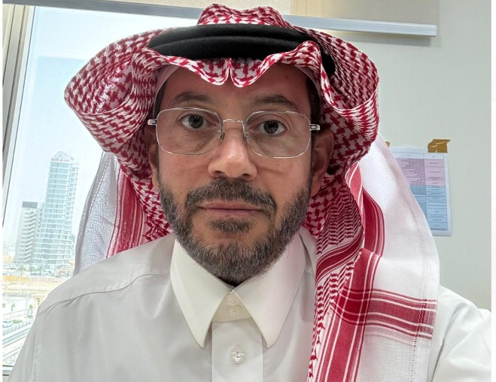

Saudi Arabia
Faisal Alrumayan
Dr. Faisal (P.h.D in electrical Engineering) is the general manager of Safety of radiation practices at the Nuclear and radiological regulatory commissioning (NRRC) in Saudi Arabia. He joined the NRRC in June 2020.

Slide 21
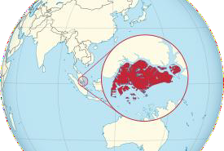


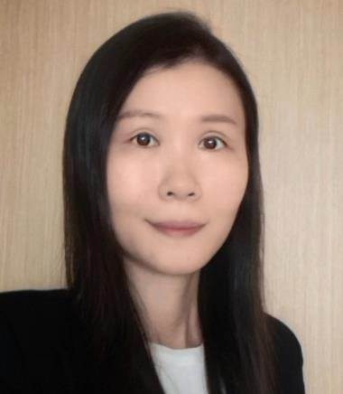
Singapore
Ms Ang Chye Peng is the Deputy Director (Regulation
Ang Chye PENG Department) of the Radiation Protection and Nuclear Science
Division in the National Environment Agency (NEA) in
Singapore since 2017. Prior to this, she worked in area of energy efficiency in the NEA from 2007 to 2013, and in the area of waste management in the Ministry of Sustainability and the Environment from 2014 to 2016. Ms Ang holds a degree in Environmental Engineering from the National University of Singapore and a Master’s degree in Sustainable Energy Futures from Imperial College London.

Slide 22

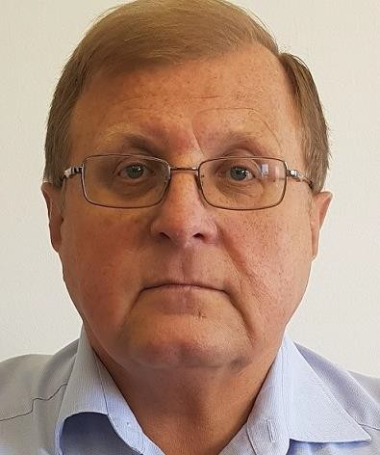

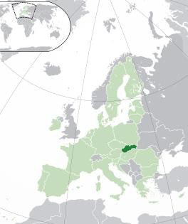




Slovak Republic
Juraj VÁCLAV
I studied nuclear engineering and thermal power engineering. I was working for the NPP Jaslovské Bohunice as Unit Supervisor. Since 2001 I have been working for the Nuclear Regulatory Authority of the Slovak Republic as Head of Nuclear Materials Division. Our Division is responsible for state supervision upon nuclear security, physical protection, safegards, storage and transport of nuclear materials.

Slide 23
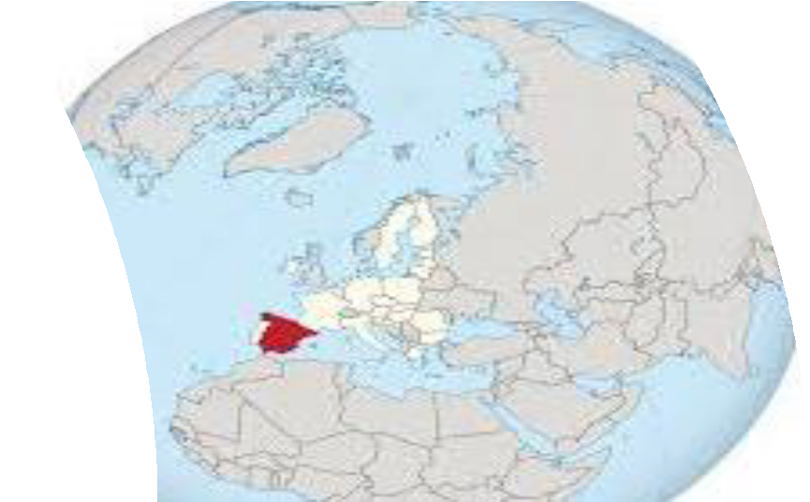


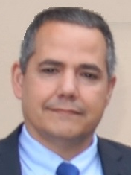

Spain
Manuel GARCÍA LEIVA
Head of the Transport of Radioactive Materials Unit of the Nuclear Safety Council, which is the competent authority for radiological protection and nuclear safety in Spain
Member of the IAEA TRANSSC Committee from 2022

Slide 24


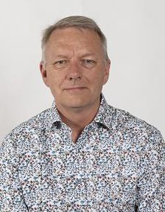

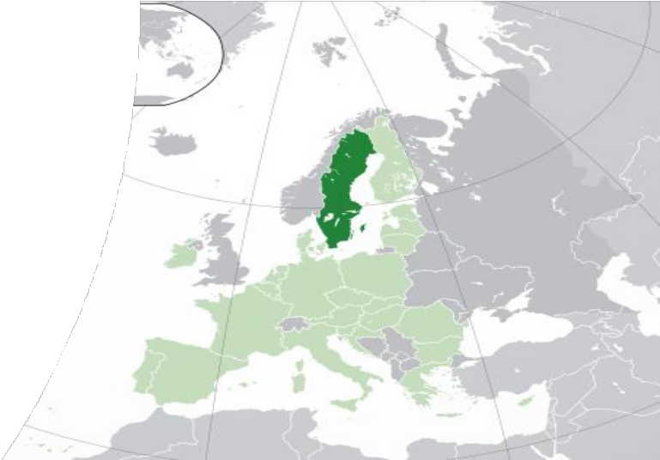
Sweden
Michael WALLIN
Michael Wallin is a senior transport safety inspector at the Swedish Radiation Safety Authority, located in Stockholm, Sweden. He has 23 years of experience of transport of dangerous goods, the last 12 years specifically on transport of radioactive material. He is also a member of the Radiation Expert Group in the Arctic Counsil’s working group EPPR, focusing on radiological activities, emergency preparedness and transport in the Arctic.

Slide 25

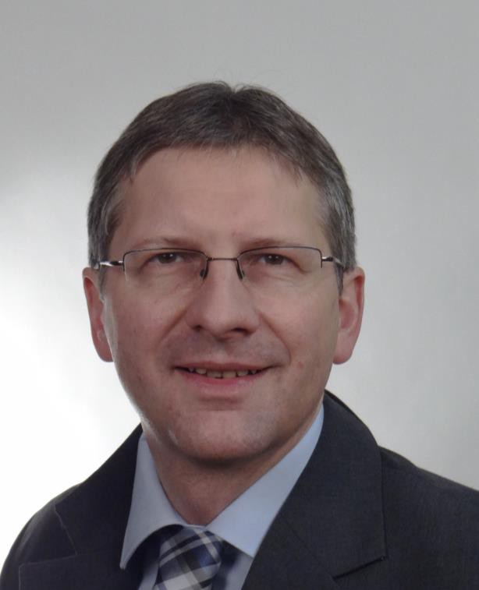


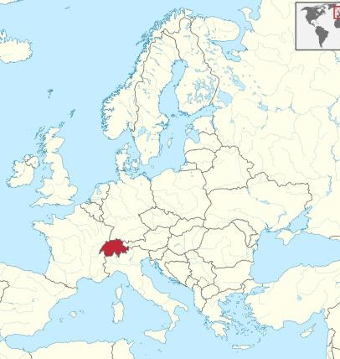
Switzerland
Frank KOCH
Swiss Federal Nuclear Safety Inspectorate ENSI, PhD in mechanical engineering, working in the field of package design since 2003, transport inspector since 2010, TRANSSC Member since 2014, currently Chair of the TTEG Package Performance and Assessment

Slide 26





Thailand
Soratos TANTIDEERAVIT
I am a nuclear engineer of the Office of Atoms for Peace, the regulatory body of Thailand. I have five years experience under the Licensing Division on the assessment of transport safety of radioactive materials, developing national legislations on transport safety and security, and licensing of the use of radioactive materials.

Slide 27





Turkey
Safiye Tuba ECEVIT
Head of Import, Export and Transport Group at the Department of Security and Safeguard, responsible for the;
Preparation of national legislation related with the import, export and transport of radioactive materials and their implementation
Making safety and security assessment for authorization applications related import, export and transport
Giving license for the companies carrying out importation, exportation and transportation of radioactive materials
Giving import/ export or transit permit for
the radioactive materials
Make necessary coordination with other national regulatory authorities regarding safe and secure transport of radioactive materials

Slide 28






United Arab Emirates Abdulla AL YAMMAHI
I'm working as radiation safety specialist in the federal authority of nuclear regulation in UAE. I had more than 10 years experience in assessment and inspections of regulated materials. Im a member of Transsc for more than 3 years.

Slide 29





United Kingdom
Christopher JONES
Chris Jones is a Nuclear Safety Inspector with the Office for Nuclear Regulation (ONR) in the UK, he has been the UK’s representative at TRANSSC since 2019. ONR is the competent authority in Great Britain for Class 7 transport by road, rail and inland waterways; ONR also provides technical support to the other modal regulators within the UK. Chris is a mechanical engineering specialist with experience in the assessment of transport packages and regulating the movement of radioactive material by road and rail.

Slide 30







United States of America
Rick BOYLE
Over 30 years leading of the Department of Transportation’s (DOT) Pipeline and Hazardous Materials Safety Administration (PHMSA) nuclear and radioactive material transport program.
Over 25 years serving as the U.S. Competent Authority for Radioactive Material and as the U.S. representative on the International Atomic Energy Agency’s (IAEA) Transport Safety Standards Advisory Committee (TRANSSC).
Authoritative voice for transport safety and security. Extensive experience presenting U.S. transport interests before nuclear power and medical industries, trade associations, foreign countries, international modal authorities and international regulatory agencies. Testified before U.S. Congress and served as expert witness in criminal trial.

Slide 31





Olivier Collard is a chemical engineer with around 15 years of experience in radiation protection in the European Commission. He works as a policy officer in DG ENERGY, focusing on health protection, health and safety at work, radiation sources management and ISO 17025 quality coordination. He is also DGSA with ADR and IATA certification. He represents the European Commission as an observer in TRANSSC since 2018.
European Commission
Olivier COLLARD

Slide 32

IATA

Slide 33




Timo LEMPIÄINEN
Airline Pilot, Finnair Airbus A320 Captain
IFALPA Dangerous Goods Committee Vice Chair
School of Chemical Engineering, Aalto University, Helsinki
(Also a handy carpenter and an adept home brewer.)

Slide 34




Florian DARRAS
Florian Darras is working in the field of the transport of radioactive materials for more than 20 years within Orano group (former AREVA and COGEMA). He has worked in design, testing, manufacturing, security, safety and operation of packages of radioactive materials. Currently, he works as an expert in the areas of security and safety for the transport of nuclear and radioactive materials in all modes and provides training for use of Dangerous Goods Regulations for transport of radioactive material. He participated in TRANSSC activities for some years, and in activities of the World Nuclear Transport
Institute (WNTI). Since 2023 he is the convenor of ISO/TC85/SC5/WG4 in charge of ISO standards dedicated to the transport of radioactive material.
ISO

Slide 35







Romain HUBERT
Dr.-Ing. Romain HUBERT joined the Sustainable Transport Division of the United Nations Economic Commission for Europe (UNECE) in February 2002. He worked in the areas of active, passive, and general safety of road vehicles and on their environmental performances.
Since June 2019, he took over the responsibilities of the Chief of the Road Safety Management and Dangerous
Goods Section of the UNECE Sustainable Transport Division.
He oversees the coordination of UNECE activities on the transport of
dangerous goods for all modes of transport.

Slide 36





Dawn WILKES
Dawn Wilkes has been seconded from the United State of America to the Universal Postal Union since 2018 as the Program Manager for Security. During this time, she has conducted successfully implemented and exceeded the key performance indicators of this position set at the Istanbul Congress in 2017.
Ms. Wilkes began her law enforcement career with the US Postal Inspection Service in 2006, during her tenure she worked a variety of assignments ranging from external and internal mail theft, mail fraud, prohibited mail, assaults, threats, and physical security. She has received multiple awards and recognitions for past casework from both within and outside the agency.
Ms. Wilkes is a native of Florida, USA and graduated with honors from the University of Florida with her Bachelor of Arts degree in history.

Slide 37








Transport Safety Unit - TSU
Shazia FAYYAZ
Head
Eric REBER
Transport Safety Specialist
Loretta MANU
Associate Transport Safety Officer
Ulric SCHWELA
Consultant
Alenka BUJNOVA
Transport Safety Specialist
Usama EJAZ
Consultant
Pengyi WANG
Consultant
Ryan AHART
Intern

